Slide 1
LECTURE PACKET #2
Survey of Microorganisms

Slide 2
Test #2 Lecture Packet
- a survey of microorganisms

Slide 3
A. Where did bacteria come from and for how long have they been present on earth?
- according to scientific theory, the earth is approximately how old?
- according to scientific theory, the oldest organisms present on earth were the simplest organisms called:
- according to fossil records, bacteria have been present on earth for approximately:

Slide 4
Where did the first cell come from?
Since no one was present to observe this event, we don’t know; what we do know is that nobody has ever created a cell from scratch in the laboratory.

Slide 5
B. Bacterial Classification
(from Bergey’s Manual of Determinative Bacteriology)
(formerly, all bacteria were classified in the kingdom
MONERA)
1. Kingdom Eubacteria a) Gram positive bacteria b) Gram negative bacteria c) Mycoplasmas (no cell walls)
2. Kingdom Archaebacteria
- hyperthermophiles
- extreme halophiles
- methanogens

Slide 6
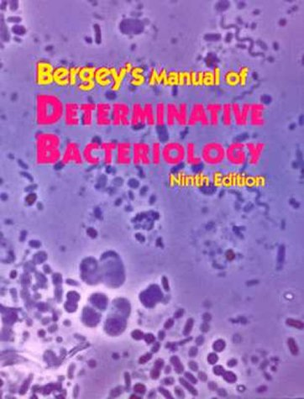

Slide 7
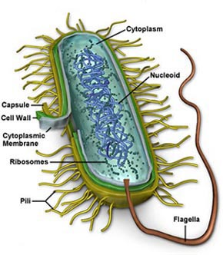

Slide 8
C. Anatomy of a Bacterial Cell
1. The Cell Envelope (glycocalyx, cell wall and cell membrane) a. GLYCOCALYX
- not found in all bacteria
- loosely attached types are called: slime layers
- mucoid, sticky, firmly bonded to the cell wall types are called: capsules

Slide 9
Both types of glycocalyx can benefit bacteria by:
- allowing better attachment to various surfaces, even when the surface is smooth (biofilms on medical devices like pacemakers, catheters, IUD’s, artificial joints; also on industrial filters and pipes; plaque)
- helping to prevent dehydration of bacteria
- helping to prevent the attachment of bacteriophages
- serving as a storage depot for nutrients
- inhibiting phagocytosis by white blood cells- this increases the pathogenicity of the bacterium (bacteria with capsules are usually noted to be more pathogenic than the same species without a capsule).
Both types of glycocalyx can also be antigenic and can stimulate the production of antibodies needed for the body to eliminate bacteria, with these structures, from the body.

Slide 10
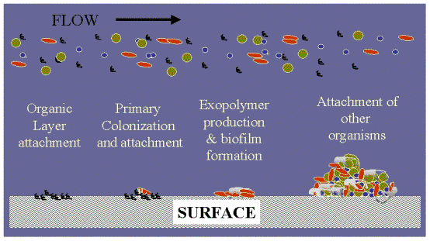
biofilms may be involved in 80% of all infections. Biofilms have been implicated in common problems including, urinary tract infections, catheter infections (pictured), the formation of dental plaque and gingivitis and even in infections in joint prostheses and heart valves.

Slide 11
b) CELL WALL
- determines the shape of the bacterium and provides strong structural support to prevent the cell from bursting and from other dangers.

Slide 12
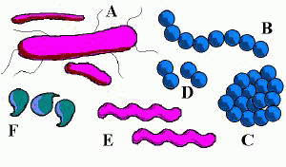
Various Bacterial Shapes

Slide 13
BACTERIA HAVE THREE (3) PREDOMINANT SHAPES
COCCUS
- coccus
- diplococci
- streptococci
- staphylococci

Slide 14
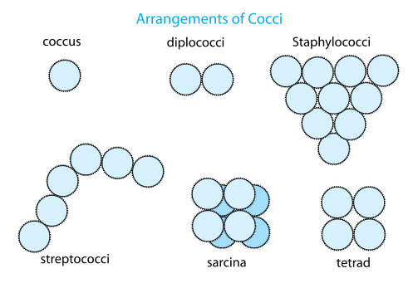
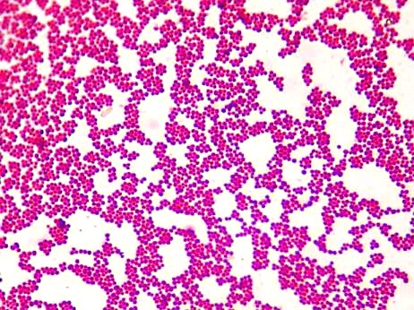
Cocci- Spherical shaped

Slide 15
BACILLUS
- bacillus
- diplobacilli
- streptobacilli
- coccobacillus

Slide 16
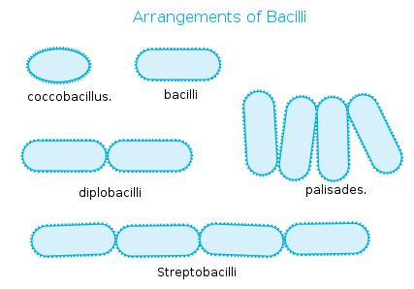
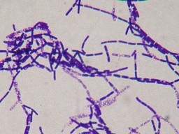
Bacilli – rod shaped

Slide 17
SPIRAL
- vibrio
- spirillum
- spirochete

Slide 18
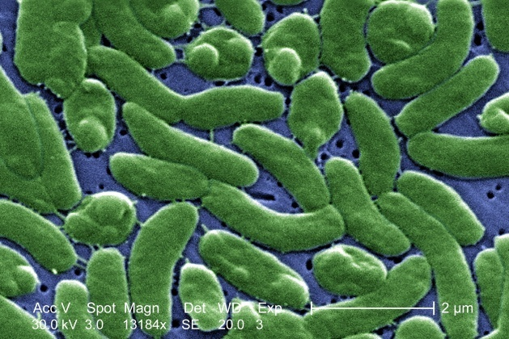
Vibrio – curved BACTERIUM

Slide 19
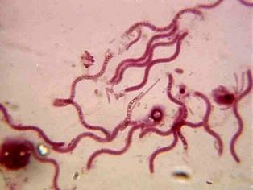
spirillum

Slide 20
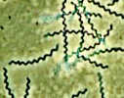
spirochetes

Slide 21
- The cell wall is a barrier to some substances.
- One of the most important molecular compounds of bacterial cell walls is PEPTIDOGLYCAN, which is unique from the cell walls of other organisms.
- Penicillin works to kill growing bacteria by inhibiting the amino acid cross links, weakening peptidoglycan and causing primarily gram positive cell walls to burst.
- Lysozymes inhibit the NAM-NAG glycosidic bonds of peptidoglycan.

Slide 22
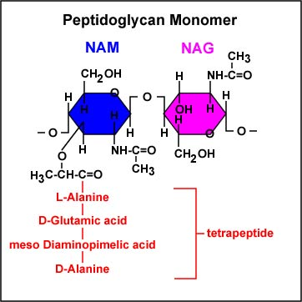
NAM = N - ACETYLMURAMIC ACID
NAG = N - ACETYLGLUCOSAMINE

Slide 23
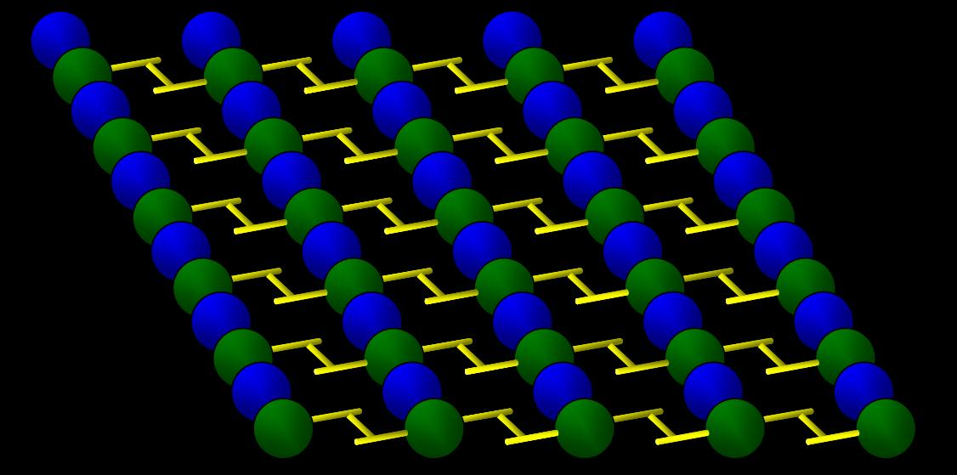

Slide 24
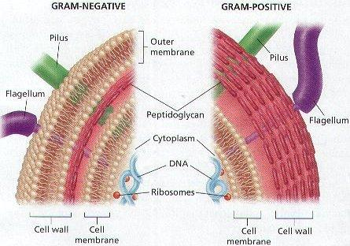

Slide 25
GRAM POSITIVE CELLS
- the cell wall and cell membrane are usually tightly pressed together
- techoic acids are incorporated into the cell wall
- when viewed through the scanning electron microscope, the surface of gram positive cells is smooth

Slide 26
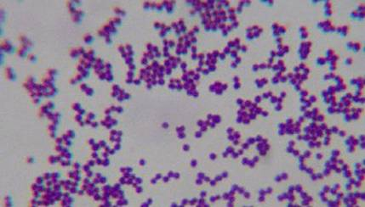

Slide 27
GRAM NEGATIVE CELLS
- these bacteria have a distinct periplasmic space between the cell membrane and the LPS layer of the cell wall
- porin proteins in the LPS (lipopolysaccharide) layer prevent the passage of some molecules, such as penicillin (most gram negative bacteria therefore aren’t affected by penicillin)
- when viewed under the scanning electron microscope, these bacteria have a rough appearing surface

Slide 28
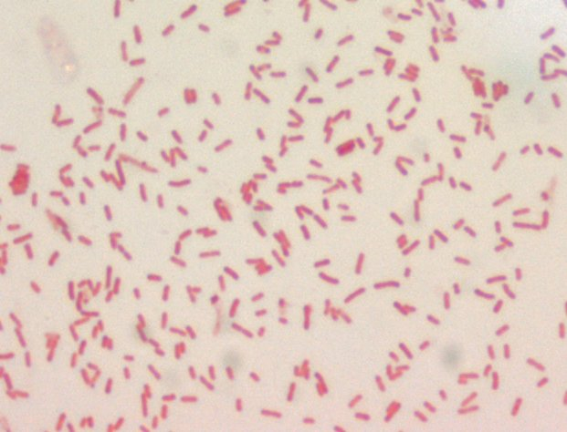

Slide 29
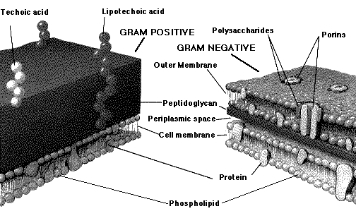

Slide 30
THE GRAM STAINING TECHNIQUE and WHY IT WORKS
Step 1: CRYSTAL VIOLET (primary stain)
- all cells stain violet
Step 2: GRAM’S IODINE (mordant or fixative step)
- creates a large crystal violet- iodine (CV-I) molecule that gets fixed to the techoic acids

Slide 31
STEP 3: Ethanol = Ethyl alcohol
(decolorizer step)
- in gram + cells, the alcohol dehydrates the cell wall trapping the CV-I complex
- in gram – cells, the alcohol dissolves the LPS layer releasing the CV-I complex
Step 4: Safranin (counterstain)
- Gram + cells remain violet
- Gram – cells stain pink

Slide 32
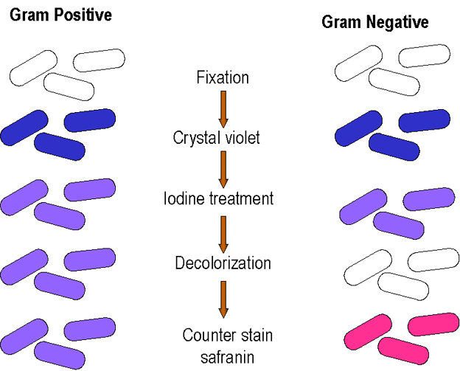

Slide 33
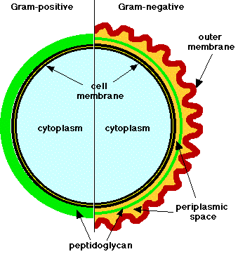

Slide 34
Gram staining is a differential staining technique.
Another differential staining technique is:
ACID FAST STAINING
- Mycobacterium spp. of bacteria have an extremely waxy component to their cell envelopes that makes them difficult to consistently Gram stain.
- Instead of Gram staining suspected Mycobacterium spp., we use the Ziehl-Neelson acid fast stain to diagnose: a) Mycobacterium tuberculosis b) Mycobacterium leprae

Slide 35
Acid fast staining technique involves:
1) CARBOLFUCHSIN
2) ACID ALCOHOL
3) METHYLENE BLUE
What is the purpose of each step of the acid fast differential staining technique?

Slide 36
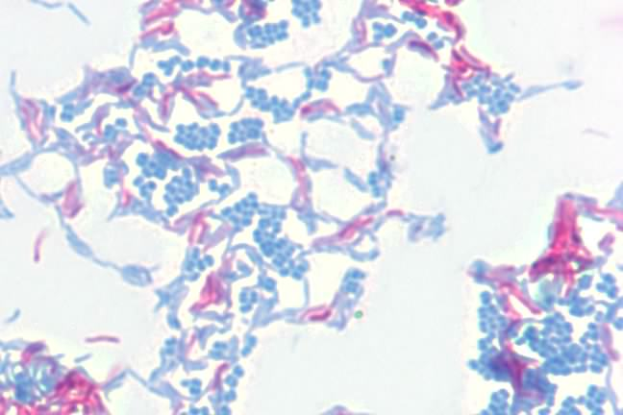
Which of these bacteria are acid fast positive?

Slide 37
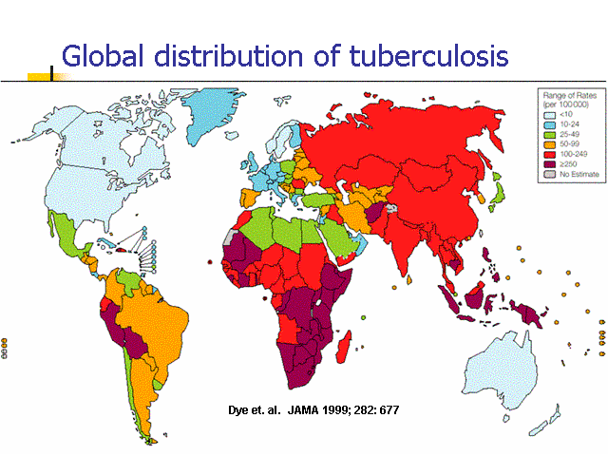

Slide 38
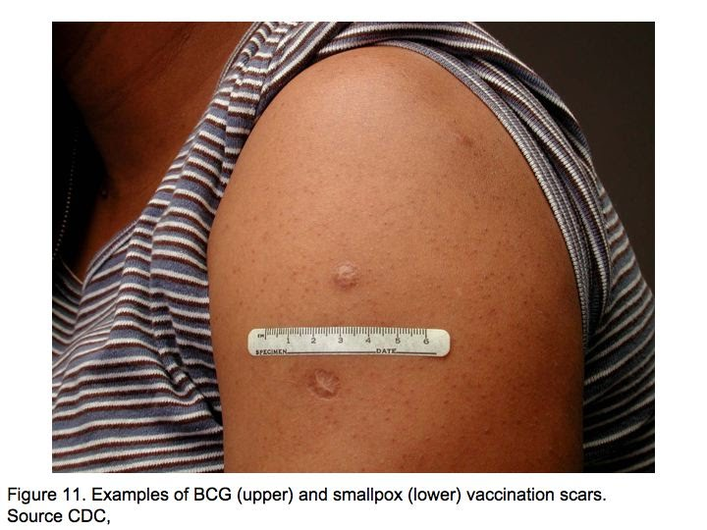
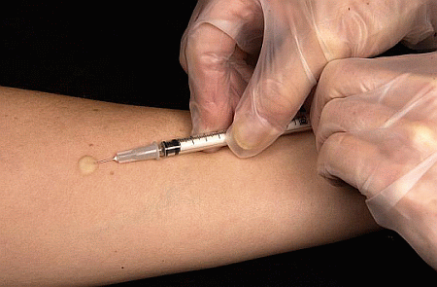
Intradermal PPD TB skin test
TB BCG vaccine scar

Slide 39
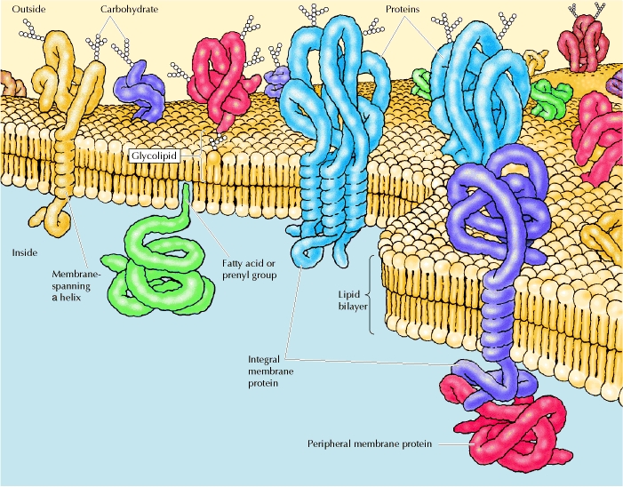
C) Cell Membrane
- the “fluid mosaic” model of cell membrane structure:
- a phospholipid bilayer with
“floating” islands of proteins embedded in it

Slide 40
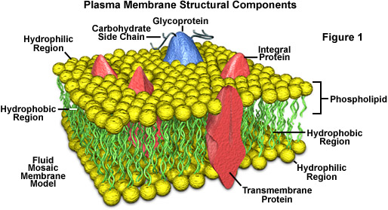

Slide 41
- Sterol lipids are found in the cell membranes of :
Eukaryotes
Mycoplasma Bacteria (there are no sterol lipids in any other bacteria)
- The lipids in the cell membranes of the archaebacteria differ from those in other kingdoms

Slide 42
The cell membrane is even more of a selective barrier that the cell wall, and determines what can enter and leave the cell.

Slide 43
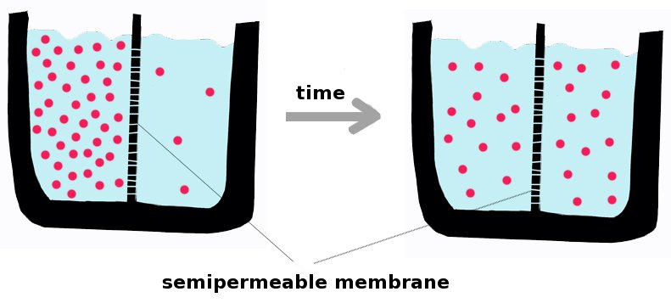
Diffusion is the movement of molecules from areas of high concentration to areas of low concentration.

Slide 44
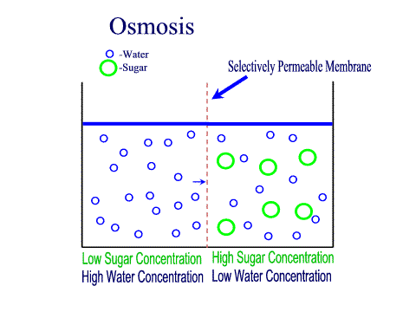
Osmosis is the diffusion of water; diffusion is a natural phenomenon and requires no energy.

Slide 45
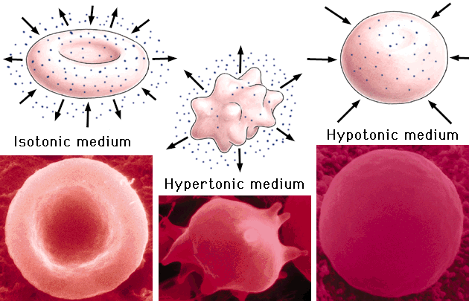

Slide 46
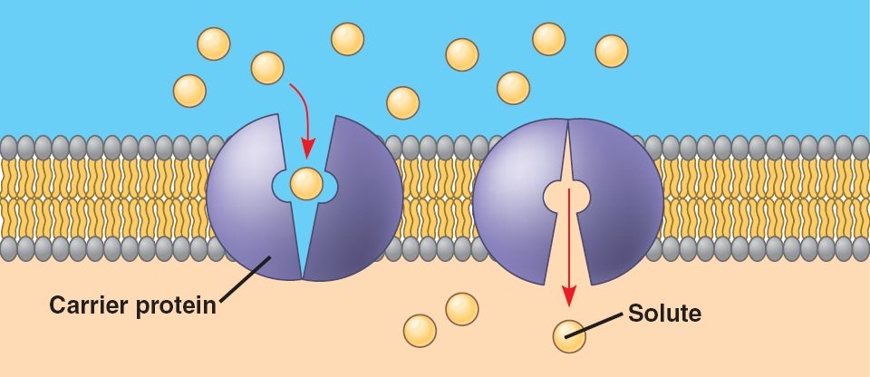
Facilitated diffusion occurs with the help of membrane protein channels ; no energy is needed.

Slide 47
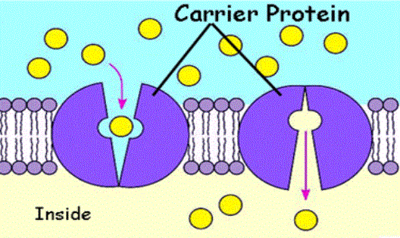
Active transport is the movement of molecules from areas of low concentration to areas of high concentration; energy is required.

Slide 48
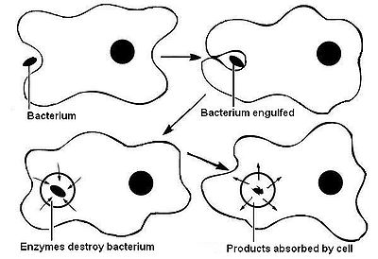
Endocytosis is the movement of large molecules too large to pass through the molecules of a membrane; the cell envelops the particle (Phagocytosis).

Slide 49
The cell membrane secretes the parts needed to make the cell wall and the appendages
(flagella, pili, fimbrae)

Slide 50
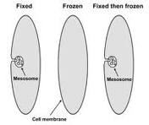
Structures called mesosomes can be seen as invaginations of the cell membrane when looking at electronmicrographs. The current theory about mesosomes is that they are “artifacts” created during the preparation of an electonmicrograph.

Slide 51
Together, all of the components of the cell envelope help to protect the cell.
PROTOPLASM
- contains about 70-80% water
(the “universal solvent” in cells)
- there are no known cytoskeletal structures (microtubules, microfilaments) that exist in bacteria and it is unknown whether bacteria exhibit “cytoplasmic streaming”

Slide 52
The Bacterial Chromosome
- consists of one circular strand of the dna double helix
- bacteria have the haploid number of chromosomes = 1; they don’t have a diploid number of chromosomes
- there is NO nucleus (they don’t have an nuclear membrane; the bacterial chromosome exists in a dense region of cytoplasm called the “nucleoid region”

Slide 53
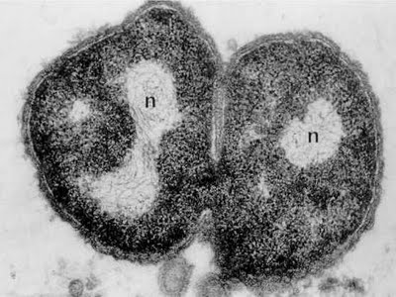
Nucleoid region

Slide 54
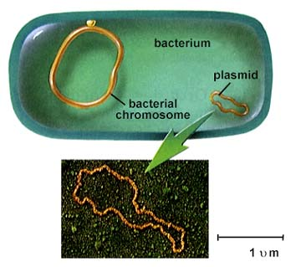
Some bacteria contain extra-chromosomal pieces of dna called plasmids.

Slide 55
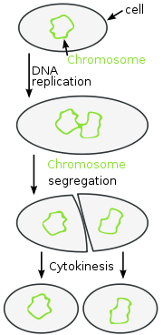
Asexual reproduction in bacteria occurs through the process of binary fission.

Slide 56
Bacteria do exchange dna between each other by several processes.
A) conjugation b) transformation c) transduction

Slide 57
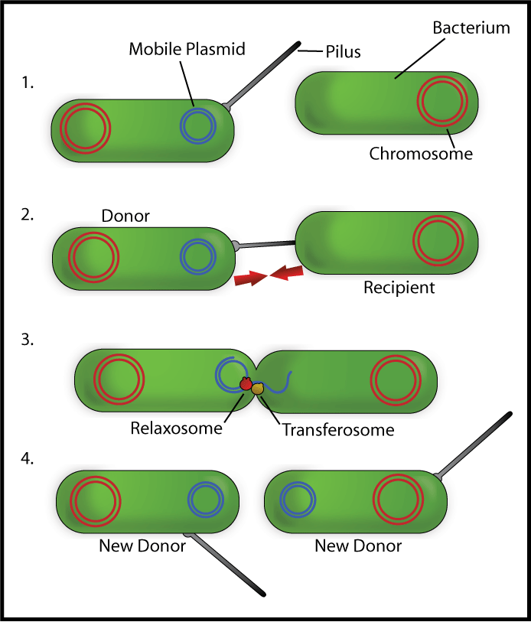
Conjugation is the transfer of bacterial dna directly from one bacterium to another.

Slide 58
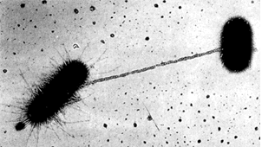
Two bacteria undergoing conjugation using a sex pilus to transfer dna from the donor to the recipient bacterium.

Slide 59
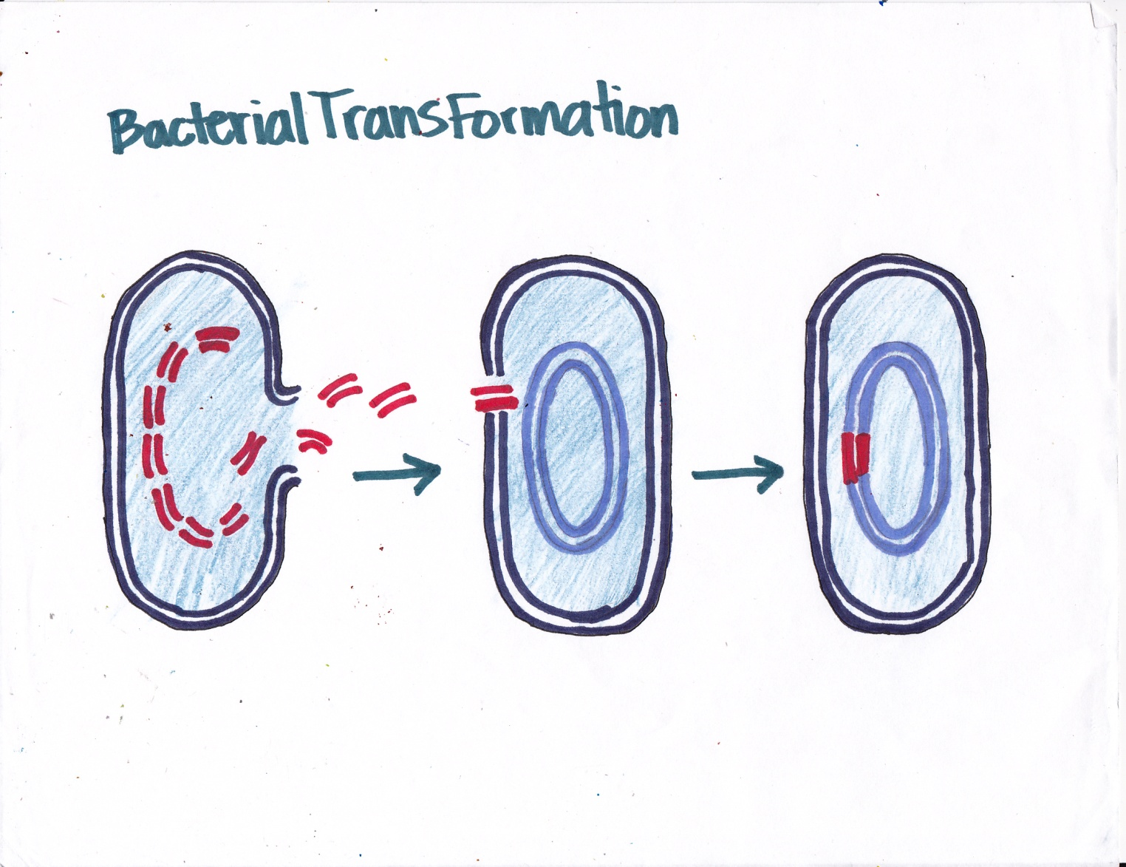
Transformation is when bacteria acquire dna that is free in their environment.

Slide 60
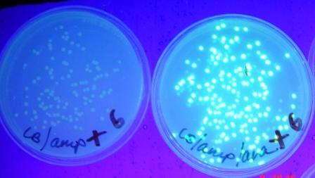
Results from the transformation experiment you will perform in lab.

Slide 61
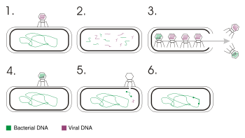
Transduction is the transfer of bacterial dna from one bacterium to another during a bacteriophage’s lytic cycle.

Slide 62
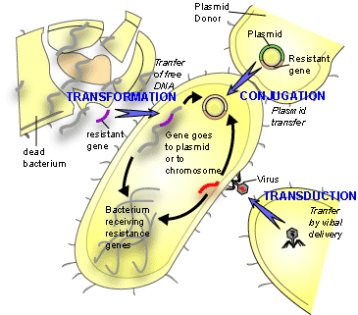

Slide 63
Ribosomes
- found in the cytoplasm, these are the sites of protein synthesis within all cells
- ribosomes are organelles that are NOT membrane bound, prokaryotic ribosomes are a combination of a 30S subunit and a 50S subunit which combined make a 70S ribosome
- tetracycline, erythromycin and chloramphenicol inhibit protein synthesis

Slide 64
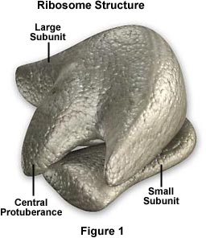
Eukaryotes have 40S and 60S subunits that together equal 80 S in size.

Slide 65
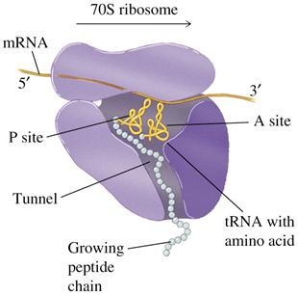

Slide 66
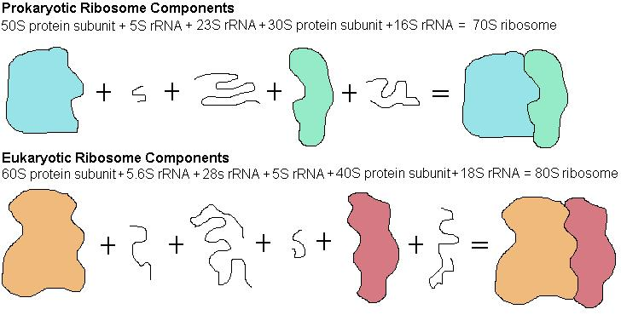

Slide 67
Granules and Inclusion Bodies
- storage vesicles for nutrients and other substances
Gas Vesicles
- protein bound organelles that assist in the buoyancy for some photosynthetic bacteria

Slide 68
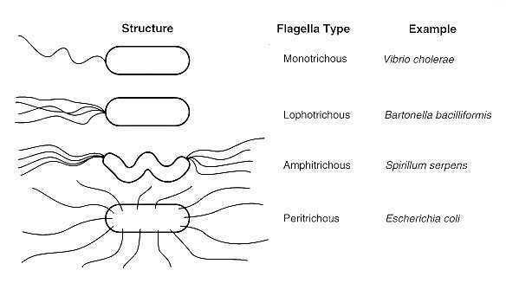
Appendages
A) Flagella- special stains are needed to see the arrangement of flagella, which can be used to help identify bacteria

Slide 69
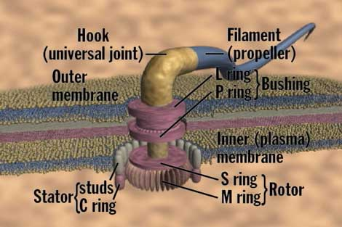
Bacterial flagella are made of a protein called flagellin which grows from the tip if the appendage.

Slide 70
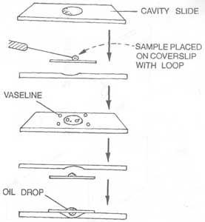
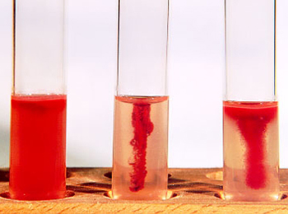
Microscopically, motility is determined by using the “hanging drop” slide technique or semisolid media
Hanging drop slide
Semisolid media- which tube contains non-flagellated bacteria?

Slide 71
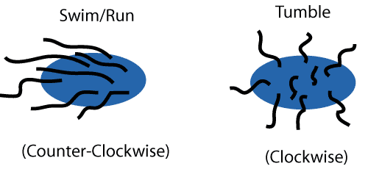
To move toward or away from a chemical stimulus (= chemotaxis), bacteria rotate their flagella producing a forward or backwards motion called runs and tumbles.

Slide 72
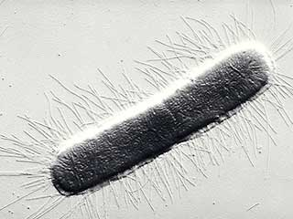
B) Fimbrae – short non-locomotor appendages used to attach bacteria to various surfaces

Slide 73
C) Pili (Pilus = singular) long non-locomotor appendages used in congugation

Slide 74

Endospores

Slide 75
Structures created within certain genera of bacteria which enable these bacteria to survive harsh conditions
(the location of spores can be used to help identify these bacteria)

Slide 76
a) Bacillus spp.
Bacillus anthracis – anthrax
B) Clostridium spp.
Clostridium tetani – tetanus (lockjaw)
Clostridium botulinum - botulism
Clostridium difficile – C. diff
Clostridium perfringens – gas gangrene

Slide 77

Tetanus

Slide 78

Infant botulism

Slide 79

Gas Gangrene

Slide 80

C. Diff – pseudo membranous colitis

Slide 81
Spores can lay dormant for centuries
(resistance to adverse conditions is due to layer over layer of peptidoglycan surrounding the dna, as well as high levels of dipicolinic acid and calcium ions; spores are dehydrated as well)
Spores are resistant to heat, acids, loss of nutrients, desiccation and radiation
When Environmental conditions are favorable, bacterial Spores “Germinate” to form
Live Vegetative Bacterial Cells Again

Slide 82

The spore cycle

Slide 83

Spore staining- the Schaeffer Fulton technique
(malachite green and safranin)

Slide 84
Spores are the reason we need to use the sterilization techniques that we do.
Spores have been used as biological warfare agents.

Slide 85
Eukaryotic cell structure

Slide 86
Remember, microbiologists also study certain types of eukaryotic cells also.
We will want to discover a few of the more common eukaryotes that microbiologists study and compare and contrast eukaryotic vs. prokaryotic cells.

Slide 87
Whereas, no one has ever created a cell and we are not sure when and where bacteria first appeared, there is a theory with interesting evidence that may show us how eukaryotes may have evolved from prokaryotes.
Theoretically, scientists believe that eukaryotes have existed for approximately 2 billion years.

Slide 88
A. The endosymbiotic theory this theory asks the question: “ could a small aerobic bacterium and a larger anaerobic heterotrophic bacterium enter into a symbiotic relationship, where the large cell phagocytized the smaller cell?”
Instead of the smaller cell being digested though, could the two organisms have entered into a situation where the two bacteria became dependent upon each other and formed the first MITOCHONDRIA?

Slide 89

Lynn Margulis

Slide 90
Some evidence to support the theory:
1) mitochondria have their own single loop of dna
2) mitochondria reproduce independently
3) mitochondria have 70S ribosomes and make their own proteins
4) mitochondria have a double membrane – 2 phospholipid bilayers
- also, could mesosomes have evolved to become the cristae of the inner mitochondrial membrane?

Slide 91


Slide 92
Another example of this theory could explain the origins of chloroplasts in algae that theoretically evolved into land plants.
- could a cyanobacterium have been enveloped by a larger bacterium, both of them becoming involved in a symbiotic relationship?

Slide 93
Evidence to support this theory is the same as in the case of the mitochondrial theory PLUS: it also turns out that the type of chlorophyll found in cyanobacteria is the same as in algae and land plants but unlike that of other photosynthetic bacteria!

Slide 94


Slide 95
B) The Autogenous Theory this theory asks the question: “could the endomembranous system of organelles be self generated through invaginations of the cell membrane?”

Slide 96


Slide 97
Comparison of Prokaryotic and Eukaryotic cells

Slide 98
NUCLEAR MEMBRANE pro - none eu – present (a double membrane with pores)

Slide 99
NUCLEOLUS pro - none eu – present in the nucleus; it is the ribosome assembly center

Slide 100
DNA pro – single circular loop eu – linear molecules with histone proteins

Slide 101
ASEXUAL REPRODUCTION pro – binary fission eu – mitosis

Slide 102
SEXUAL REPRODUCTION pro – conjugation eu – meiosis → fertilization

Slide 103
CELL MEMBRANES pro - no sterols (except mycoplasmas) eu – contain sterols (cholesterol in animal cell membranes)

Slide 104
RIBOSOMES pro - 70S eu - 80S (except in mitochondria and chloroplasts)

Slide 105
MEMBRANE BOUND ORGANELLES pro – none eu – mitochondria, chloroplasts, golgi bodies, endoplasmic reticulum (er), lysosomes

Slide 106
CELL RESPIRATION
(glucose + o₂ → co₂ + h₂o + atp) pro – in the cytoplasm and on cell membrane eu – in the cytoplasm and mitochondria

Slide 107
PHOTOSYNTHESIS
(co₂ + h₂o –light→ glucose + o₂) pro – chlorophyll on folds of cell membrane eu – chlorophyll in chloroplasts

Slide 108
CELL WALLS pro – peptidoglycan eu – plants contain cellulose fungi contain chitin

Slide 109
GLYCOCALYX pro – some have eu – some have

Slide 110
ENDOSPORES pro – Bacillus spp.
Clostridium spp.
Eu – none

Slide 111
GAS VESICLES pro – photosynthetic bacteria eu – none

Slide 112
APPENDAGES pro – flagella, pili, fimbriae eu – flagella, cilia, pseudopods

Slide 113
MICROTUBULES pro – none eu – the “9 + 2” arrangement of microtubules in flagella and cilia, centrioles, spindle fibers, cytoskeleton

Slide 114
SIZE pro – usually less than 10 μicrons eu – usually greater than 10 microns

Slide 115
Microbiologists study the following types of eukaryotes: a) protozoa – protozoology b) algae – phycology c) fungi – mycology d) invertebrate animals
(worms, insect transmitted diseases) – parasitology

Slide 116
THE KINGDOM PROTISTA

